Slide 1

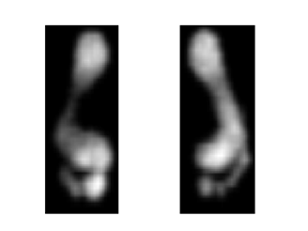
Deep learning in Time series Classification
Saeed Kazemi
Notes:
Hello everyone,
I am Saeed and my partner in this project is Maryam, our presentation is about Time series classification.

Slide 2
Presentation Contents
The problem and Dataset
Feature Extraction and Selection
Deep Learning Algorithm
Machine Learning Algorithm
Results and Discussion
Notes:
First of all,,,, let's look at the outlines.
In the first step,,,, we look at the problem as well as ,,,,, our Dataset
Afterward, we talk about features extracting,,,.
Then ,,,,,,,,,the Machine learning approaches as well as Deep neural networks are reviewed
and in the final,,,,, we gonna discuss about results.

Slide 3
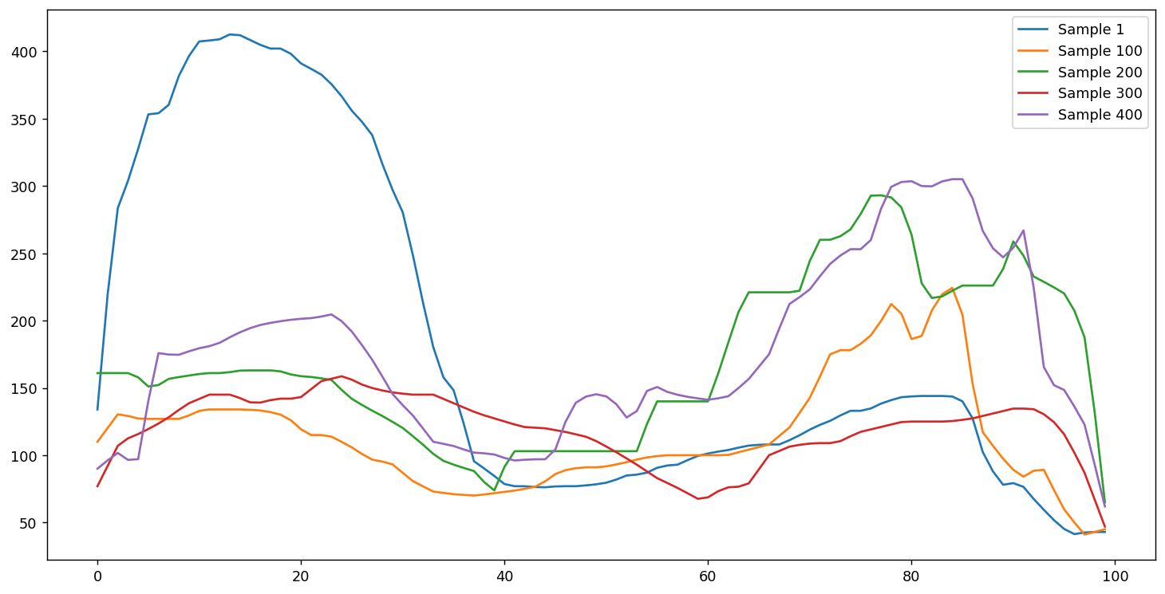
Describing the problem
Classification on time series data
Notes:
So let start The aim of this project is to do classification and achieving labels on time series data

Slide 4
The Dataset
Stepscan datasets was used in this project
Stepscan dataset is a video-based dataset.
Obtained from high resolution floor tiles.
1744 Samples * 200 frames * (80 * 60) images
80 subjects
Each subject has approx. 20 samples
Verification mode was used for this research.
Notes:
In order to have data for testing our method we used step scan dataset which is a video based dataset and is obtained from High-resolution floor tiles. We considered 1744 samples in this program and considered 200 frames from the video which its dimension is 80 by 60 .

Slide 5
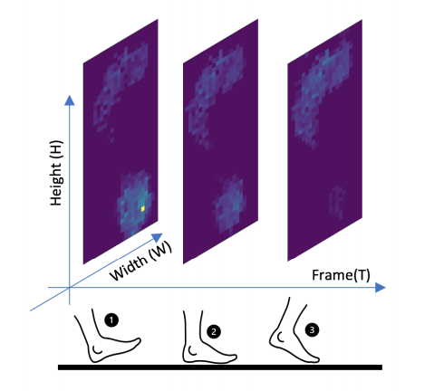
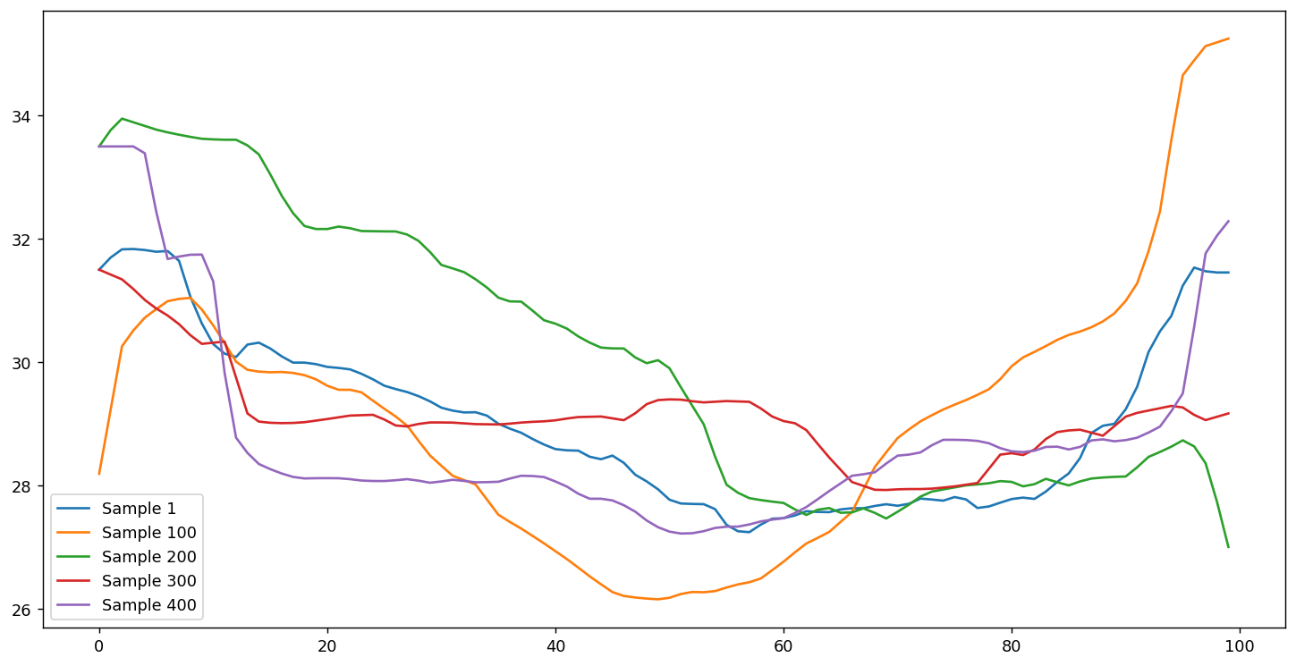
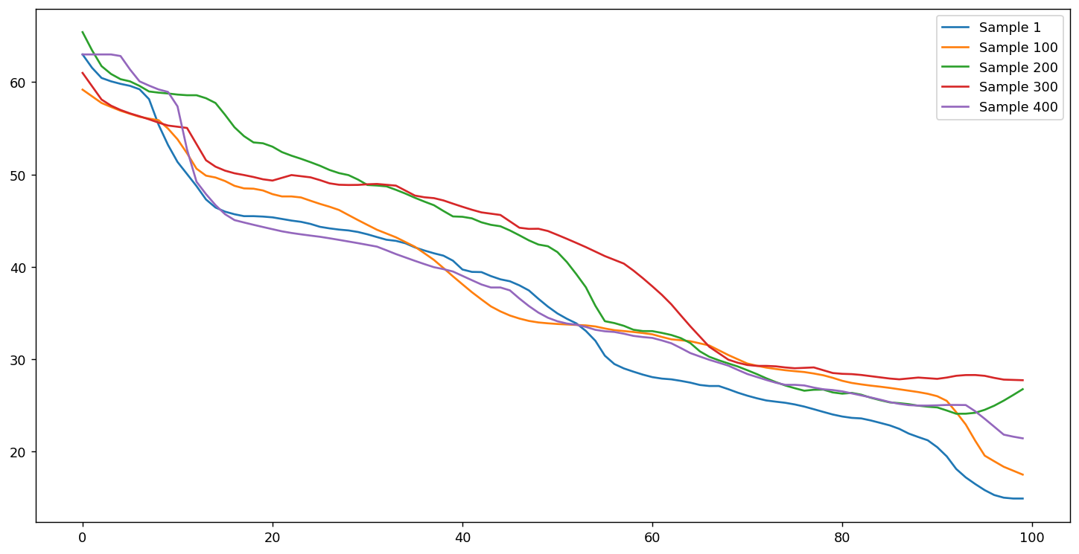
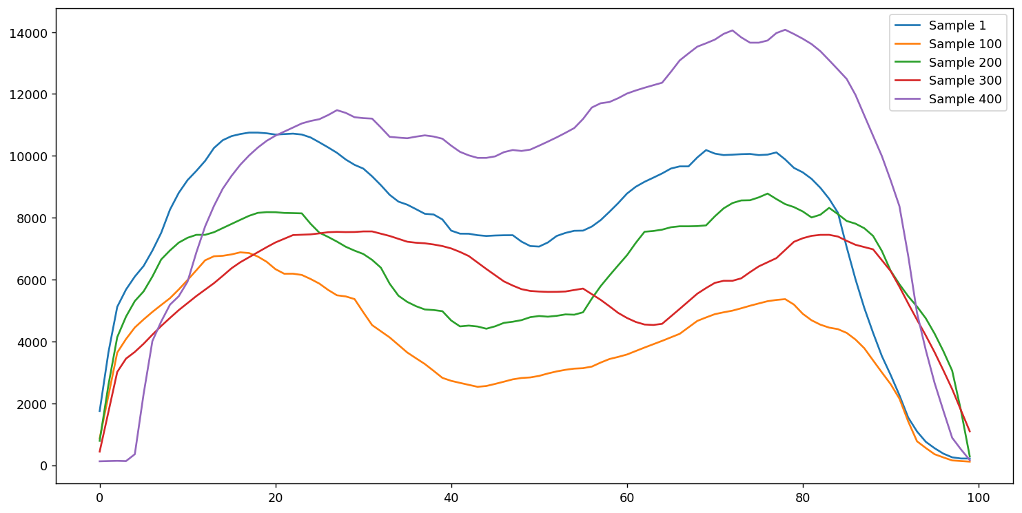
convert a video data to time series.
Considering some frame s
Extracting 4 features from each frame
Track those features in each frame
Achieving four 2D time series
Notes:
The point is that we want to use time series data sets to implement ML algorithms . So since the nature of step scan data set is a video based data set we should convert it to a time series data set to be able to use it for this project. There are some methods to convert a tensor, I mean a video based data set, to time series data set . For this purpose, we considered some frames from video and then we extracted the values of our features from each frame . Then we tracked the values of extracted features over time and finally a 3d videos converted to the four 2d time series data.
Four features that we achieved them by tracking their values in frames are shown in this slide, named Maximum and average pressure in each frame, The X and Y position in the center of pressure in each frame. So four-time series have been prepared and now we have to extract features from these time series data set to be able to apply the machine learning algorithms to them to do classification.

Slide 6
Feature Extraction and Selection
Two different approaches were used for feature extraction:
Handcrafted features
Extraction of 4 groups of features
Autoregressive coefficients Features
Temporal Features
Spectral Features
Statistical Features
low variance and high-correlated features were deleted
Deep learning features
Used pre-trained CNN to extract features automatically
Notes:
We can do feature extraction by two methods, handcrafted features which we do it manually and Deep learning methods which is done automatically . After extraction of the features We categorized the features into 4 groups. named Temporal features, Spectral features, statistical features and Autoregressive coefficient features.
THEN in order to reduce the complexity of our program , the high correlated features were deleted

Slide 7
Machine Learning Approaches
Implemented several (LDA, KNN, SVM, RFC)
20% percent of samples were set aside for testing the classifier,
The rest was divided into 10-fold cross-validation for evaluation and training.
The grid search were implemented to find the best hyper-parameters.
knnspace = {
"model__n_neighbors": np.arange(1, 22, 2),
"model__metric": ["euclidean", "manhattan", "chebyshev"],
"model__weights": ["distance", "uniform"],
"sfs__k_features": [100, 200, 300]}
svmspace = {
"model__probability": [True],
"model__kernel": ["rbf", "linear"],
"model__decision_function_shape": ["ovr", "ovo"],
"model__C": [0.1, 10, 1000],
"model__gamma": [1, 0.01, 0.0001],
"model__random_state": [seed],
"sfs__k_features": [100, 200, 300]}
treespace = {
"model__max_depth": np.arange(3, 33, 2),
"model__criterion": ["gini", "entropy"],
"sfs__k_features": [100, 200, 300]}
Notes:
After extraction of features now we are going to implement several algorithms or classifiers , named LDA , KNN, SVM, Random forest to do classification for us . we are gonna do 10-fold cross-validation. So firstly, we set aside 20 percent for the testing part and remained will be divided into 10-fold cross-validation for evaluation and training
The other thing is hyperparameter. And we know that for example k in KNN and C in SVM are hyperparameter and we have to find the best value of them. So in order to find the best hyperparameter which gives the highest performance we do grid search in the spaces showed in this slide.
. ….

Slide 8
Deep learning algorithms
“Hand crafting” features requires domain knowledge
Deep learning uses nested neural networks to automatically learn what aspects of the data are important
There are many architectures for time series deep learning:
LSTM
CNN-LSTM
ConvLSTM
Fully Convolutional Networks (FCN)
Echo State Networks (ESN)
Most architectures are used for time series data
 | Machine learning | Deep learning
Size of raining data set | Small | Large
Feature Extraction | Yes | No
Debugging | Easy | Hard
Training Time | Short | long
Notes:
So, Another method that we have used for this project called deep learning
As we saw in the couple last slides, ,,,,,,,the extraction of meaningful features ,,,,,,,is one of the challenging tasks,,,,,,,,,, in conventional machine learning approaches. Therefore,,,,,,, Deep learning could be a good solution. ,,,,,,,,,For using this networks ,,,,,,,, we need a large number of training set as well as a Significant computational resources for training.
As you can see, these are Some of DNN networks that are Mostly used for time series data

Slide 9
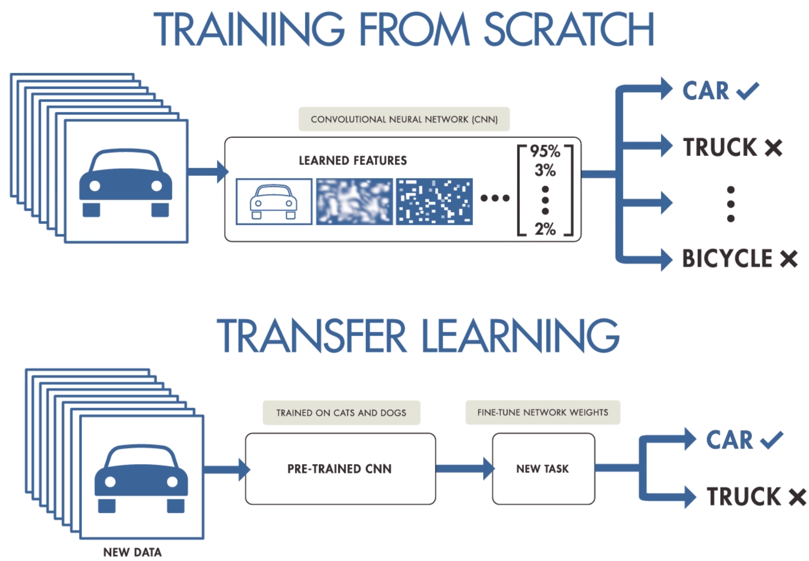
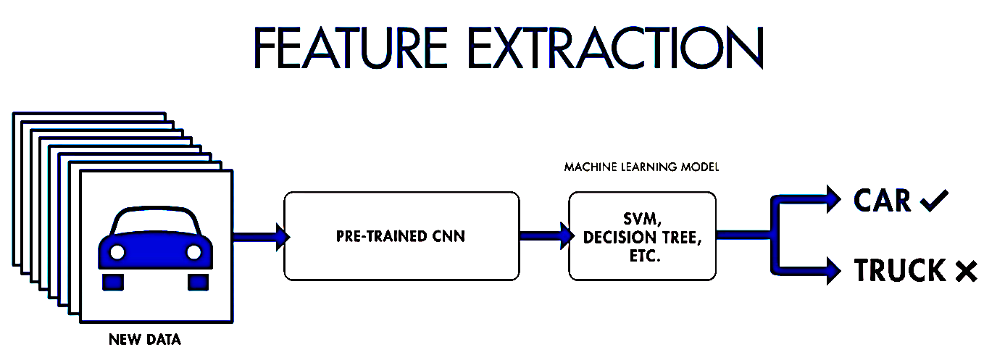
Deep learning algorithms
1
2
3
Notes:
well, how can we use these networks?
there are three ways to use deep learning in general.
The first method is to train the network totally based on our data. ,,,,,,,,,,,,,This approach is highly accurate.
But it’s not practical for problems that have a small dataset,
The second method relies on transfer learning,,,,,,,,,,,,,,, in this method we can use a pre trained networks ,,,,,,,,,,,,,,,,,,,,,,to solve a similar problem.
This method is mostly used for image data
With the third method,,,,,,,,,,,,,,,,,,,, we can use a pre-trained network ,,,,,,,,,,,,,,,,as a feature extraction block and
Use another Machine learning method for classification.
In the next two slides,,,,,,,,,,,,,, I am gonna go deep in,,,,,,,,,,,, the implemented algorithms

Slide 10
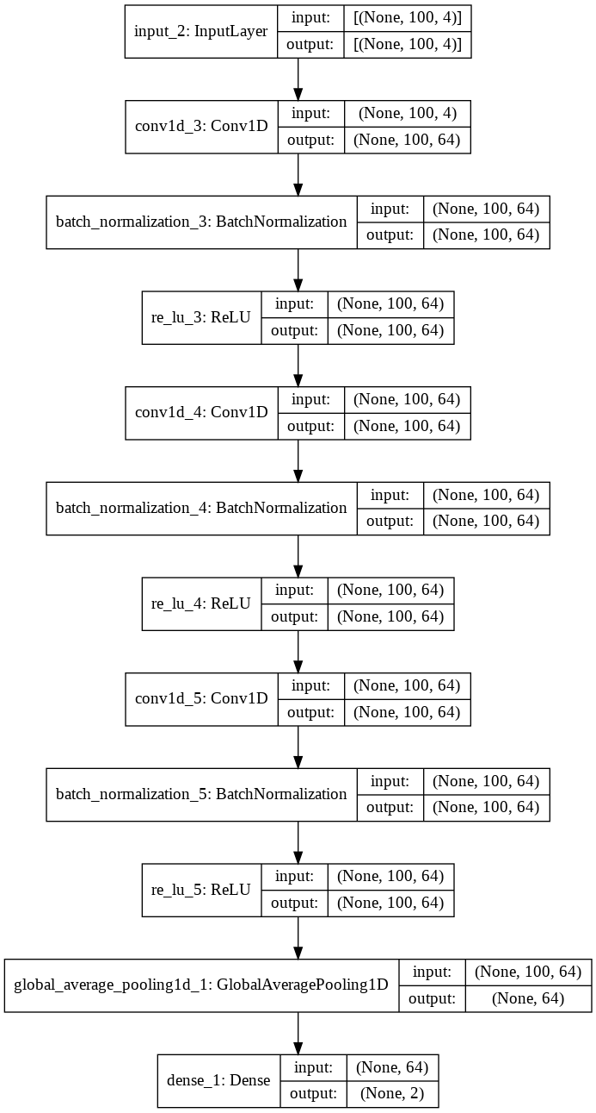
end-to-end method
We also implemented DNNs as end-to-end networks (FCN)
This network has three blocks.
Each block is a convolutional layer followed by a batch normalization and a ReLU activation layer.
Hyper-parameters:
epochs = 200
batch_size = 32
optimizer="adam”
loss="sparse_categorical_crossentropy"
Trainable params: 26,050
Notes:
Here is the first one ,,,,,,,,,,,,,,which we implemented a Fully Convolutional Networks (FCN)
As you can see ,,,,,,,,,,,,this network has three blocks.
And,,,,,,,,,,,Each block has a convolutional layer along with a batch normalization and a ReLU activation layer.
Also ,,,,,,,,,,,I am gonna put emphasis on ,,,,,,,,,,,,,,,,,,the training parameter that is about 26_000

Slide 11
Transfer learning method
Implemented LDA, kNN, SVM, and RFC.
We used Ricker wavelet (“Mexican hat wavelet”).
Compared 2 CNN architectures ImageNet for pre-training the CNN (VGG16, and MobileNet)
The size of testing data was considered 20%
Model* | Image size | Weighted size | Length of features | Learning parameters | Number of layers
VGG16 | 224 x 224 | 535 MB | (1, 4096) | 138,357,544 | 23
MobileNet | 224 x 224 | 17 MB | (1, 1024) | 4,253,864 | 88
* https://github.com/SKazemii/CS6735,
Notes:
As the second way, we also used transfer learning method,
We have used two CNNs,,,,,,,,,,,,, VGG16 and Mobilenet ,,,,,,,,,,,,,,,to extract the features and then,,,,,,,,,,,, implemented four machine learning algorithms,,, to classify the samples.
As mentionned,,,,,,,,,,,,,,,,,,, our dataset is not enough to train a deep network. ,,,,,,,,,,,,,,,,,,,,,,,,,,For example,,,, we have at least 4 million learning parameters in VGG16, whereas our dataset has less than 2 000 images
furthermore, ,,,,,,,,,,These frameworks were implemented in python by using the Keras and scikit learn package, ,,,,,,,,,,,,and the codes are available ,,,,,,,,,,,on the GitHub repository.
for this reason ,,,,,,,,,,,we downloaded these parameters from the ImageNet website.

Slide 12
The pipeline of implemented algorithms
Conventional ML algorithms
Features Extracting
Feature Selection
SVM, kNN, LDA, RFC
Calculating Accuracy
Video base dataset
Conventional
ML algorithms
Transfer learning approach
Converting to time series
Wavelet Transform (CWT)
VGG16
MobileNet
SVM, kNN, LDA, RFC
Calculating Accuracy
Transfer
learning
End-to-end Method
Fully Convolutional Networks (FCN)
Calculating Accuracy
End-to-end
Method
Notes:
To recap, we used three different frameworks
In the first framework,,,,,,, we extracted handcrafted features and fed to four different algorithms
In the second one,,,,,,,,,,,,, we used Wavelet transform to convert each time series to image and then ,,,,,,,,,,,,,,,extracted features automatically by two pre-trained networks VGG16 and MobileNet
And finally, ,,,,,,,,,,,,,,,,,,,a Fully convolutional networks were used for classification

Slide 13
Test scenario
50 Known Users
30 Stranger Users
50 binary models
Training set
Test set
Imposter set
16 samples
(in-class)
4 samples
(in-class)
20 *30 samples
(out-class)
≈200
16 *49 samples
(out-class)
≈800
4 *49 samples
(out-class)
≈200
*Train/Test Split 80/20​
**K-fold =10
Notes:
So before seeing results lets talk about the test scenario
As mentioned, we have 80 different users in the Stepscan dataset that each user have about 20 samples,
We separated the first 50 users as our training and testing dataset and set aside others as a Stranger data, our models never seen these samples during the training
Since our problems is verification, we developed 50 binary classifier for each user
Now for training phase we used 80 present of green dataset in 10-fold cross validation.
As you can see, the dataset is an unbalance dataset. Therefore, I used StratifiedKFold
to keep the same percentage of samples of each class ,,,,,,,,,,,,,,as the complete set.
In the rest of this presentation, I will report the result of test set

Slide 14
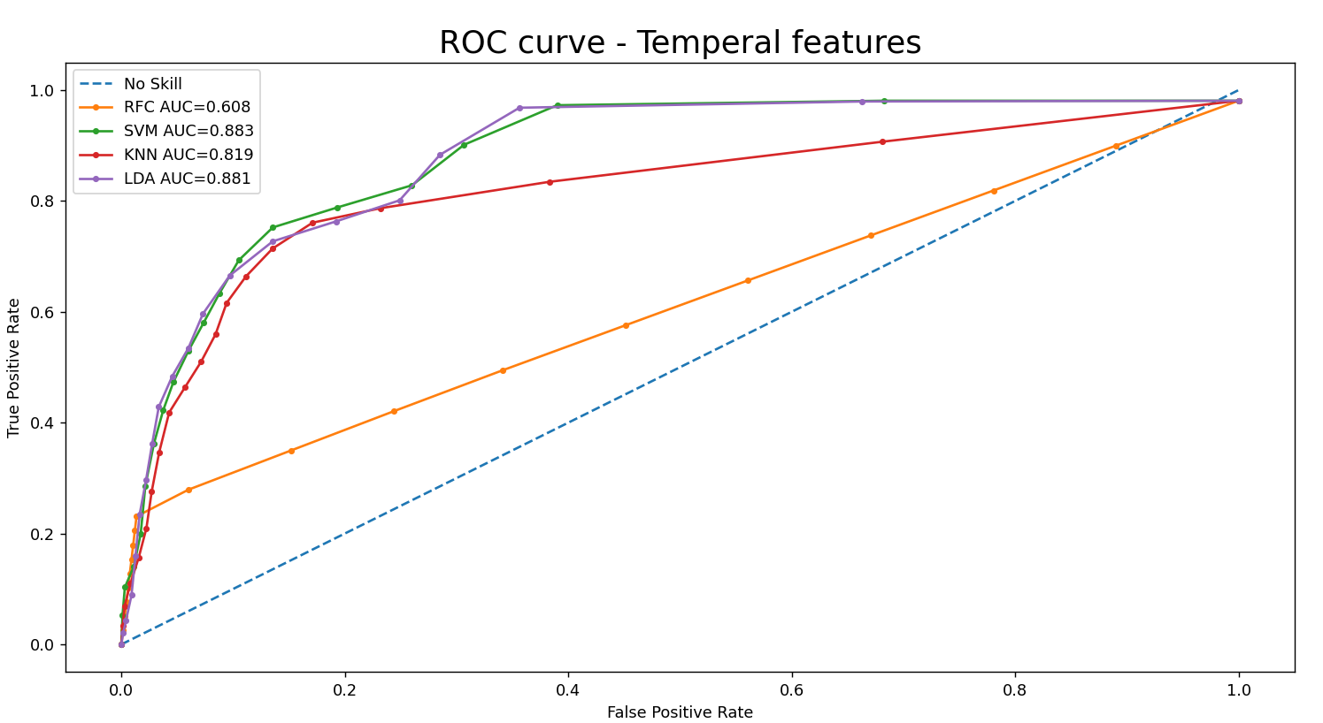
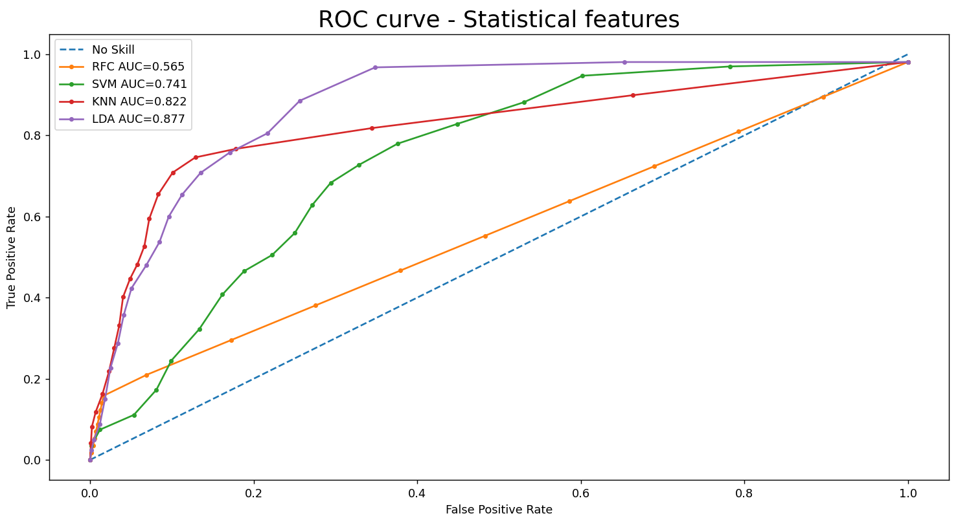
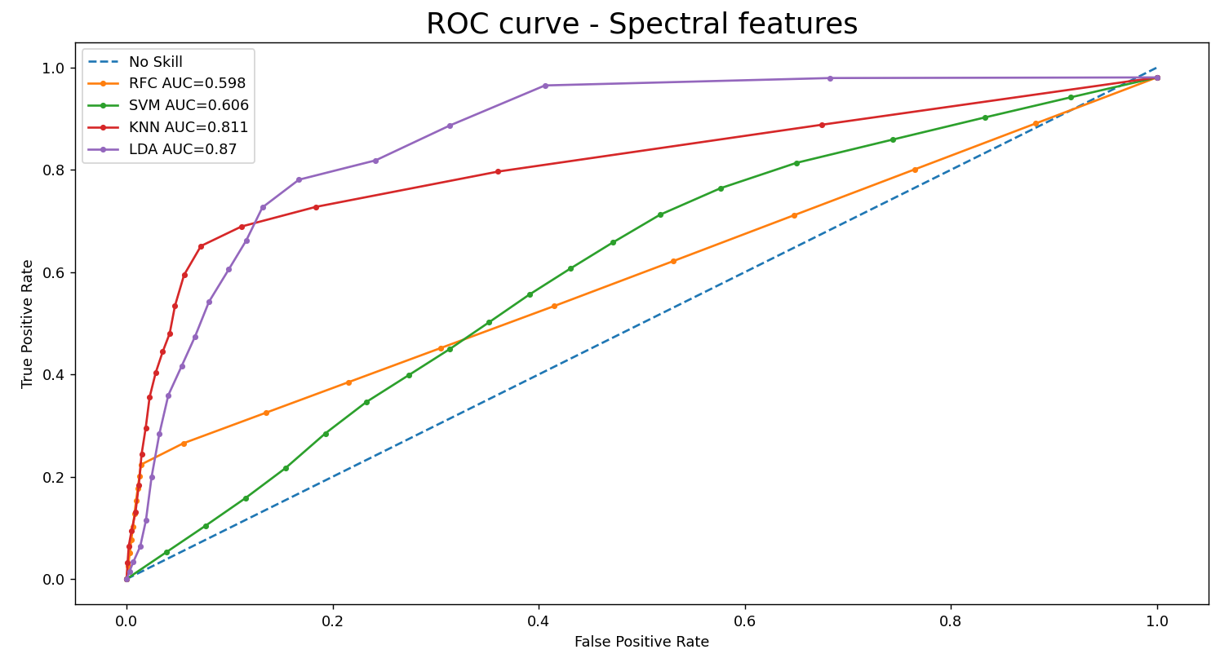
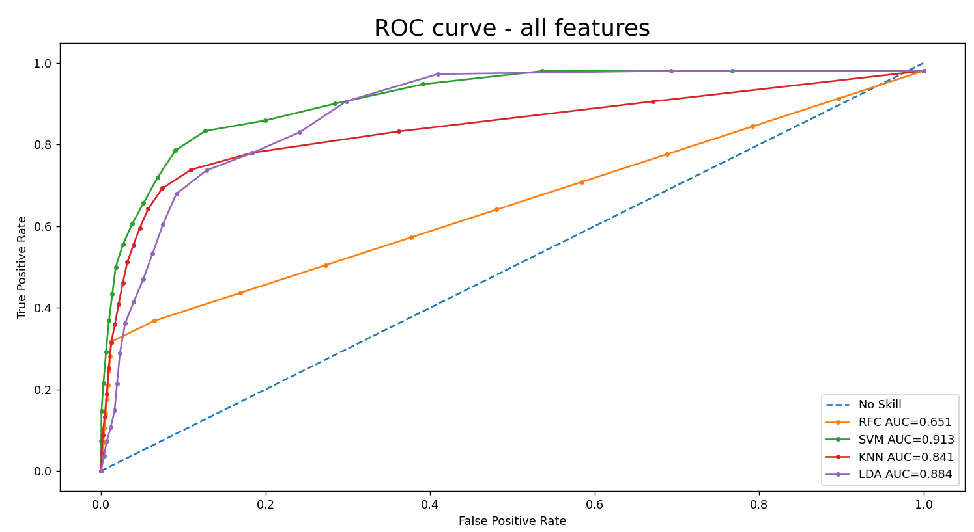
Results and Discussion
Notes:
As we already said that we extracted 4 categories of features and here we show the performance the ML algorithm on these features by ROC curve and AUC area. ROC curve (receiver operating characteristic curve) is a graph showing the performance of a classification model. This curve plots two parameters:
True Positive Rate
False Positive Rate
To compute the points in an ROC curve, there's an efficient, sorting-based algorithm that can provide this information for us, called AUC. AUC stands for "Area under the ROC Curve.
So the bigger area imply the better performance . As you observe all MLs show the better performance in the last graph which is related to combination of all features.

Slide 15
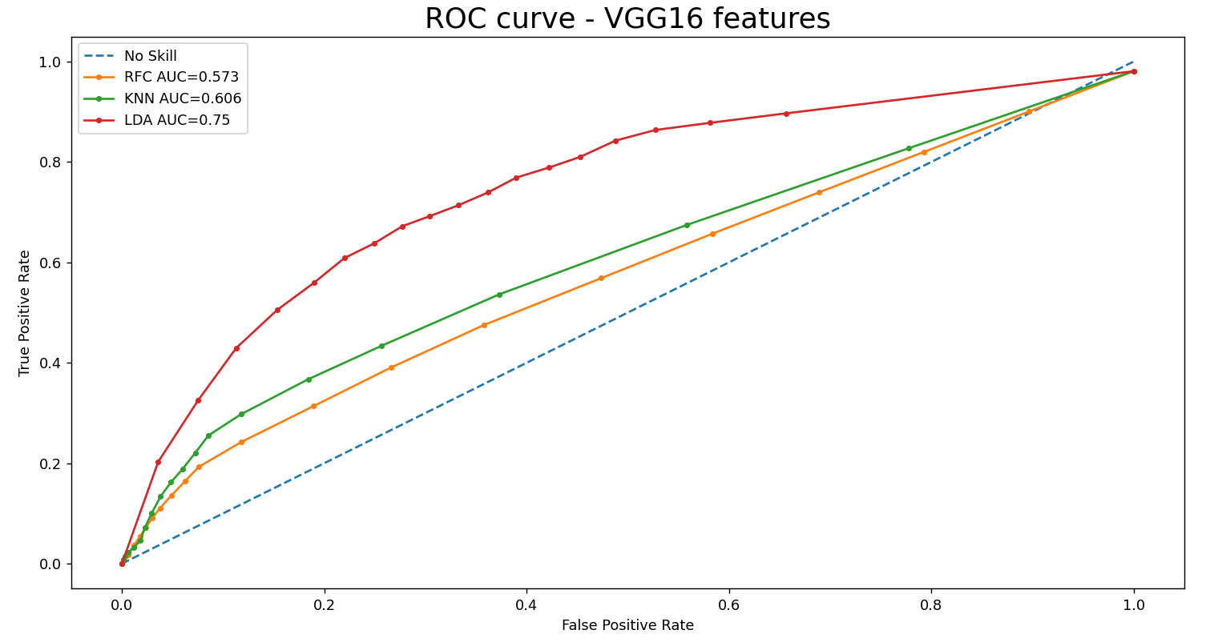
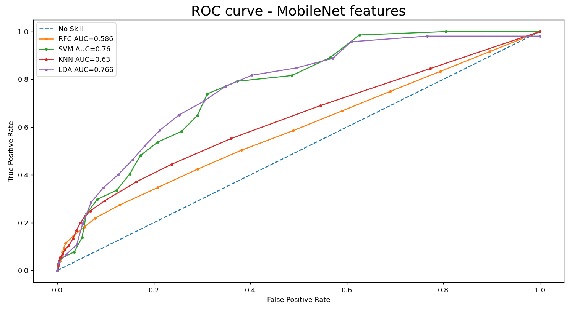
Results and Discussion
Notes:
another way of extraction of features is to use of two CNN structure named VGG 16 and mobile net to extract the features and then implement our 4 algorithms to do classification. That’s why we also showed the ROC curve for our 4 ML algorithms when we extracted the features through VGG 16 and mobile net methods

Slide 16
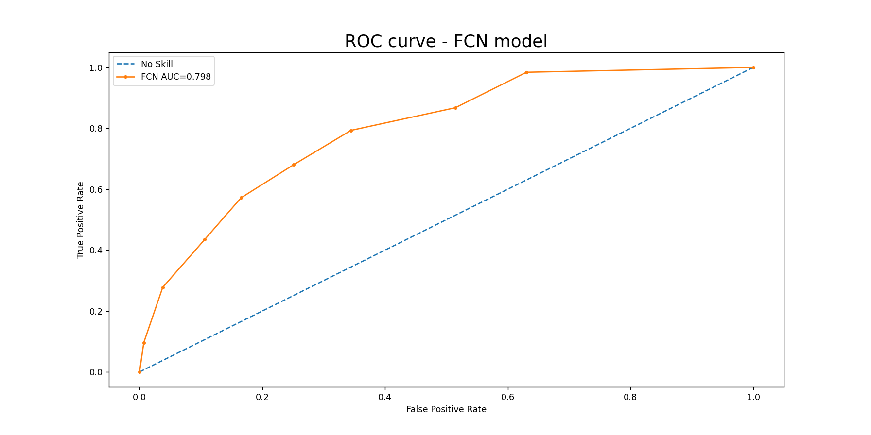
Results and Discussion
Notes:
Fully Convolutional network was the third way of extraction of the features which is completely done automatically …...Now let compare all the results in the next slide

Slide 17
Results and Discussion-AUC
Conventional ML algorithms |  | LDA | SVM | KNN | RFC
 | Temporal Features | 0.881 | 0.883 | 0.819 | 0.608
 | Spectral Features | 0.870 | 0.811 | 0.606 | 0.598
 | Statistical Features | 0.877 | 0.822 | 0.741 | 0.565
 | All Features | 0.884 | 0.913 | 0.841 | 0.651
Transfer learning |  | LDA | SVM | KNN | RFC
 | MobileNet Features | 0.766 | 0.760 | 0.630 | 0.586
 | VGG16 Features | 0.750 | - | 0.606 | 0.573
End-to-end Method |  | FCN
 | MobileNet Features | 0.798
Notes:
Here you see all three methods feature extraction ….If we focus in the conventional method we see that SVM in temporal features did the best , LDA in spectral and statistical had the highest performance. And the interesting point is that all features had the highest performance in the forth row which is related to combination of all features.......
Now look at the second way which we implement VGG16 and mobile net on extracted features and show that LDA performed better that the remaining algorithms.
The third one is related to FCN which had the performance of 0.798
Although we do not use a perfect DNN, the result of networks are not good as much as conventional neural network

Slide 18
Results and Discussion- EER
Conventional ML algorithms |  | LDA | SVM | KNN | RFC
 | Temporal Features | 0.215 | 0.203 | 0.222 | 0.438
 | Spectral Features | 0.193 | 0.412 | 0.228 | 0.441
 | Statistical Features | 0.206 | 0.306 | 0.206 | 0.465
 | All Features | 0.202 | 0.147 | 0.202 | 0.402
Transfer learning |  | LDA | SVM | KNN | RFC
 | MobileNet Features | 0.298 | 0.286 | 0.404 | 0.452
 | VGG16 Features | 0.306 | - | 0.418 | 0.453
End-to-end Method |  | FCN
 | MobileNet Features | 0.285
Notes:
Here you see all three methods feature extraction ….If we focus in the conventional method we see that SVM in temporal features did the best , LDA in spectral and statistical had the highest performance. And the interesting point is that all features had the highest performance in the forth row which is related to combination of all features.......
Now look at the second way which we implement VGG16 and mobile net on extracted features and show that LDA performed better that the remaining algorithms.
The third one is related to FCN which had the performance of 0.798
Although we do not use a perfect DNN, the result of networks are not good as much as conventional neural network

Slide 19
Results and Discussion- ROC

Slide 20
Thank you
Question?
Notes:
Thank you very much for your attention
I am open to any question

